Slide 1
VIRTUAL MOUSE CONTROL USING EYE MOVEMENT
GUIDED BY
Mr.V.PUGAZHENTHI,M.E(CSE).,
PRESENTED BY
KAVIYA G
USHA KUMARI

Slide 2
ABSTRACT
Controlling the mouse by a physically challenged person is really a tough one. To find a solution for the people who cannot use the Mouse physically, we have proposed this mouse cursor control using Eye Movements. Eye gaze is an alternative way of accessing a computer using eye movements to control the mouse. For someone who fine touchscreens, mouse inaccessible, eye gaze is an alternative method to allow a user to operate their computer, using the movement of their eyes. Eye movement can be regarded as a pivotal real-time input medium for human-computer communication, which is especially important for people with physical disability. In order to improve the reliability, mobility, and usability of eye tracking technique in user-computer dialogue, a novel eye control system is proposed in this system using Webcam and without using any extra hardware. The proposed system focuses on providing a simple and convenient interactive mode by only using user’s eye.

Slide 3
OBJECTIVE
The scope of our project is to make the work of ‘amputees’ (people who don’t have their arms to be operational) easy. Amputees or quadriplegics can benefit from our project (people affected by paralysis of all four limbs) can use and operate the mouse using their facial features and actions of their eyes.
This project will design a system that will just require a camera to employ human eyes and facial characteristics as a pointing device for the computer system. The following are the objectives:
Eyes and face Detection
Eye end points extraction
Develop an algorithm to calculate the point gaze based on eye features extracted
Develop a GUI that shows a result
Develop a Calibration technique

Slide 4
DOMAIN-DEEP LEARNING
Deep learning is a machine learning technique that teaches computers to do what comes naturally to humans: learn by example. Deep learning is a key technology behind driverless cars, enabling them to recognize a stop sign, or to distinguish a pedestrian from a lamppost. It is the key to voice control in consumer devices like phones, tablets, TVs, and hands-free speakers. Deep learning is getting lots of attention lately and for good reason. It’s achieving results that were not possible before.
In deep learning, a computer model learns to perform classification tasks directly from images, text, or sound. Deep learning models can achieve state-of-the-art accuracy, sometimes exceeding human-level performance. Models are trained by using a large set of labeled data and neural network architectures that contain many layers.

Slide 5
INTRODUCTION
Personal computers were initially used for solving
mathematical problems and word processing. In recent years,
however, computers have become necessary for every aspect of
our daily activities. These activities range from professional
applications to personal uses such as internet browsing,
shopping, socializing and entertainment.
The method described in this paper is distinctive because
unlike existing methods we did not use electrodes, infrared, or
any other light source to track the eyes. The only hardware that
is required is a PC or laptop along with a webcam, which
makes it practical and feasible.

Slide 6
LITERATURE SURVEY
Title | Year | Author | Alogorithm | Detection techniques | Detecting range
Virtual Mouse with RGB Coloured Tapes | 2016 | N. Scott, C. Green, and S. Fairley. | bounding box algorithm. | RGB colored tapes. | 1metre
AI Virtual Mouse Using Hand Gesture Recognition | 2022 | Joy Guha, Shreya Kumari | Machine learning algorithm | Coordinates in hands. | 5metre
Real-time virtual mouse system using system using RGB-D images fingertip detection | 2021 | Dinh-Son Tran | K-cosine algorithm | Media Pipe | 4metre
Hand Gesture Recognition System as Virtual Mouse for HCI (GLOVE) | 2021 | Venkateshwar A, Maheshwari Prakash Bhairawadag, Pavan Kumar P, Goutham U, Kalyan Kumar P | machine learning algorithm. | Colored gloves | 5metre

Slide 7
EXISTING SYSTEM
Chin et al. proposed a cursor control system for computer users, which integrated the electromyogram signals from muscles in the face and point-of-gaze coordinates produced by an eye-gaze tracking system as inputs. Although it could facilitate a reliable click operation, it was slower than the control system that only used eye tracking and the accuracy was low.
Missimer and Betke constructed a system that uses the head position to control the mouse cursor and simulates left-click and right-click of the mouse by blinking left or right monocular. This system relied on the position of user’s head to control the mouse cursor position. The irregular movement of user’s head would affect the accuracy of click function.
Lupu et al. proposed a communication system for people with disabilities, which was based on a special designed device composed of a webcam mounted on glasses frame for image acquisition and processing. The eye movement is detected by the device and the voluntary eye blinking is correlated with a pictogram or keyword selection reflecting patient’s needs.

Slide 8
DISADVANTAGES
The existing system designed eye trackers are quite complicated and expensive.
Users should wear inconvenient devices and make specific actions to control the system.
In the existing system user should choose the desired function first and then do the real interaction with computer, which goes against user intuition and it is not natural to use.

Slide 9
PROPOSED SYSTEM
In this paper, we have described a system that has facial tracking, detection of face, detection of eye and continuous eye blinks for controlling a human computer interface.
The mouse cursor is controlled by head movement as moving face up, down, sidewise movements and mouse events such as right and left click are controlled through eye blinks and squinting using OpenCV. This system is mainly for disabled people to have effective communication with the computer. Human eye movement has been used in the place of the conventional mouse. The main aim of this system is to help physically challenged and amputee people especially person who do not have their arms.
Camera receives the input from the eye. After receiving these streaming videos from the camera, it will break into frames. After receiving frames, it will check for lighting conditions because cameras require sufficient lights from external sources

Slide 10
ADVANTAGES
Increased time productivity due to reduction of mouse interaction.
Increases HCI for physically challenged people.

Slide 11
SYSTEM REQUIREMENTS
HARDWARE REQUIREMENTS
System : Pentium i3 Processor.
Hard Disk : 500 GB.
Monitor : 15’’ LED
Input Devices : Keyboard, Mouse
Ram : 4 GB

Slide 12
SOFTWARE REQUIREMENTS
Operating system : Windows 10.
Coding Language : Python
Web Framework : Flask

Slide 13
MODULES SPECIFICATIONS
Importing the necessary libraries
Open cv
Eye detection Using Dlib
How It Works
Eye-Aspect-Ratio (EAR)
Mouth-Aspect-Ratio (MAR)
Prebuilt Model Details

Slide 14
MODULES DESCRIPTION
Importing the necessary libraries:
We will be using Python language for this. First we will import the necessary libraries such as
open cv
dlib
for building the main model

Slide 15
Open cv:
Open CV (Open Source Computer Vision Library) is an open library of python that is mainly aimed at real-time computer-vision. It is also available in C++ and Java. It is an open source machine learning software library. It makes use of Numpy, which is a python library that is used for implementing multi-dimensional arrays and matrices along with high-level mathematical operations on these arrays. OpenCV is mainly used to capture data from a live video hence it is mainly focuses on image processing and video capture. In this paper OpenCV is focused mainly on video capture. OpenCV is also used for applications such as face detection, OCR, Vision-guided robotics surgery, 3D human organ reconstruction, QR code Scanner etc., Using OpenCV we can perform detection of specific objects such as eyes, faces etc., we can also analyze videos such as estimating the motion in the video or subtracting the background from the video, and tracking objects in it.

Slide 16
Eye detection Using Dlib:
The first thing to do is to find eyes before we can move on to image processing and to find the eyes we need to find a face. The facial keypoint detector takes a rectangular object of the dlib module as input which is simply the coordinates of a face. To find faces we can use the inbuilt frontal face detector of dlib. You can use any classifier for this task. If you want high accuracy and speed is not an issue for you then I would suggest you use a CNN as it will give much better accuracy especially for non-frontal facing faces

Slide 17
How It Works:
This project is deeply centered around predicting the facial landmarks of a given face. We can accomplish a lot of things using these landmarks. From detecting eye-blinks in a video to predicting emotions of the subject. The applications, outcomes, and possibilities of facial landmarks are immense and intriguing.
Dlib’s prebuilt model, which is essentially an implementation of , not only does a fast face-detection but also allows us to accurately predict 68 2D facial landmarks. Very handy
Using these predicted landmarks of the face, we can build appropriate features that will further allow us to detect certain actions, like using the eye-aspect-ratio (more on this below) to detect a blink or a wink, using the mouth-aspect-ratio to detect a yawn etc or maybe even a pout.

Slide 18
Eye-Aspect-Ratio (EAR):
You will see that Eye-Aspect-Ratio is the simplest and the most elegant feature that takes good advantage of the facial landmarks. EAR helps us in detecting blinks and winks etc.
You can see that the EAR value drops whenever the eye closes. We can train a simple classifier to detect the drop. However, a normal if condition works just fine

Slide 19
Mouth-Aspect-Ratio (MAR):
Highly inspired by the EAR feature, I tweaked the formula a little bit to get a metric that can detect opened/closed mouth. Unoriginal but it works.
Similar to EAR, MAR value goes up when the mouth opens. Similar intuitions hold true for this metric as well.

Slide 20
Prebuilt Model Details:
The model offers two important functions. A detector to detect the face and a predictor to predict the landmarks. The face detector used is made using the classic Histogram of Oriented Gradients (HOG) feature combined with a linear classifier, an image pyramid, and sliding window detection scheme
You can get the trained model file from http://dlib.net/files, click on shape_predictor_68_face_landmarks.dat.bz2. The model, .dat file has to be in the project folder.

Slide 21
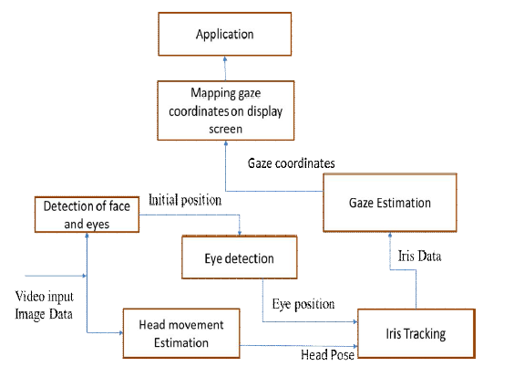
ARCHITECTURAL DESIGN

Slide 22
IMPLEMENTATION & METHODOLOGY
A. Face detection
In order to capture the face image accurately, the user sat
upright with the eye level parallel to the webcam.
B. Extracting eye area
In order to extract the eyes region, the image of the face is
divided into three equal horizontal areas. The upper third where the eyes are located is extracted.

Slide 23
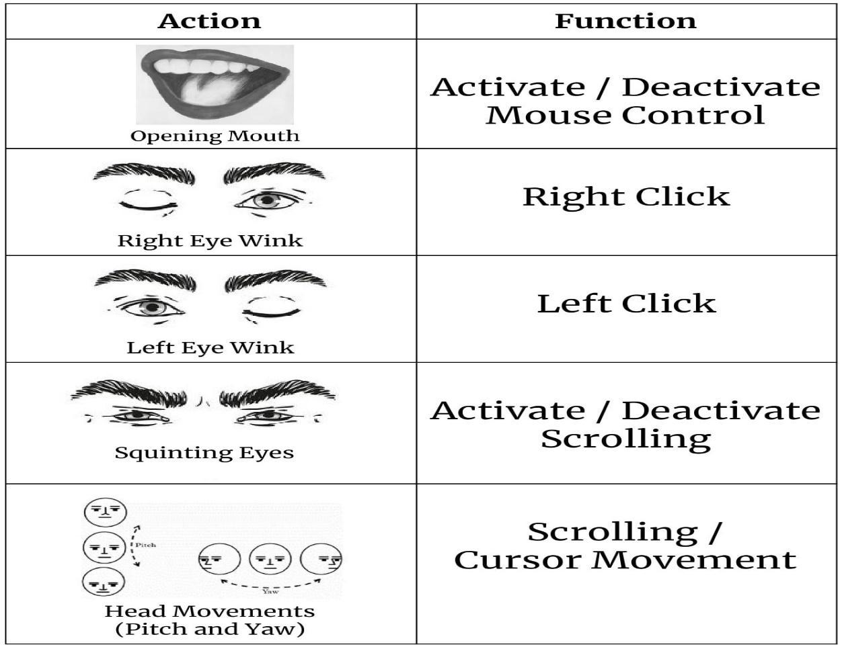
C. Tracking eye movement

Slide 24
IMPLEMENTATION & METHODOLOGY
The first step was to use a face detection algorithm locate the face on an image frame captured by an ordinary webcam.
The next step was to detect only the eyes from this frame. We consider tracking only one eye movement for faster processing time. Then the iris movement was tracked.
Since the color of the iris is black, its image has a significantly lower intensity compared to the rest of the eye. This helps us in easy detection of the iris region.
Taking the left and right corners of the eye as reference points, the shift of the iris as the person changed his eyes focus was determined.
The shift was then used to map cursor location on the test graphical user interface (GUI)

Slide 25
BLOCK DIAGRAM
Face detection
Eye Tracking
Opencv
Real time Video capturing from web-cam
Performing, different mouse operation

Slide 26
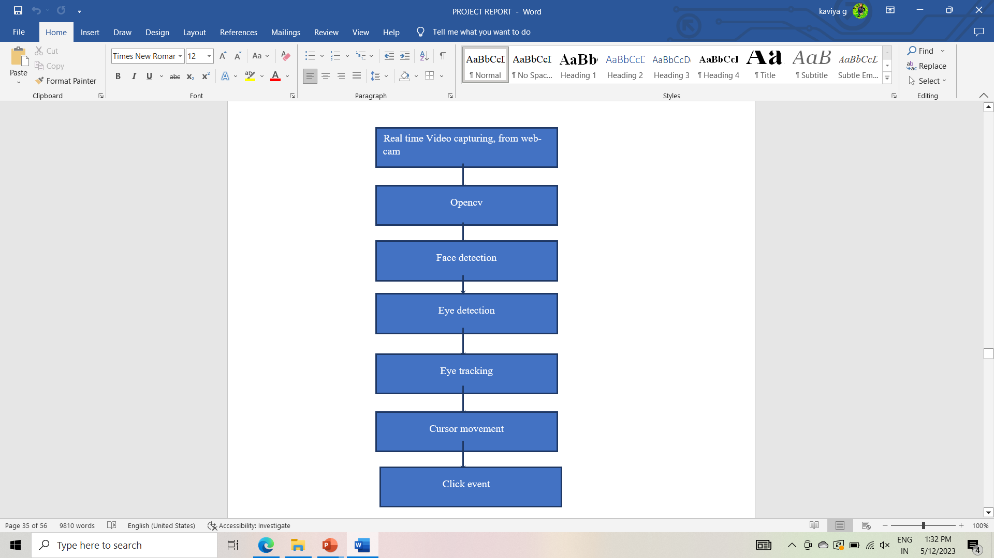
DATA FLOW DIAGRAM

Slide 27
USECASE DIAGRAM
Real time video
Face detection
User
Eye detection
Eye tracking and mouse movement

Slide 28
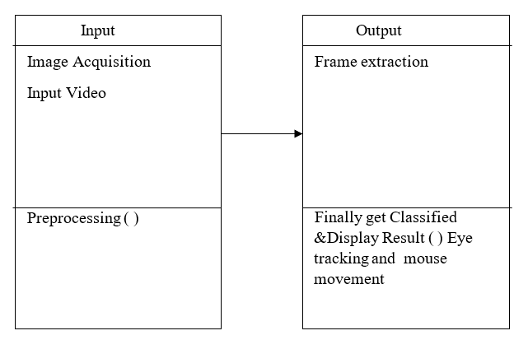
CLASS DIAGRAM

Slide 29
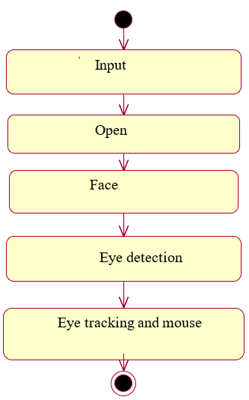
ACTIVITY DIAGRAM

Slide 30
SEQUENCE DIAGRAM
Data collection
Testing
Training
Real time Video from the Web camera
Send the data to the detection stage
Perform Preprocessing
Face Detection
Eye Detection
Eye Tracking
Predict Click type using Open cv

Slide 31
FUTURE ENHANCEMENTS
Currently, this system is applied for the general operating behavior to interact with computer by simulating mouse. In future, we will try to add new operation functions for more usage situations for users to communicate with media and adjust our system on new platform, such as tablet or phone. We will also develop series operation modules in order to achieve a complete operating experience for users from turning on to turning off the computer.

Slide 32
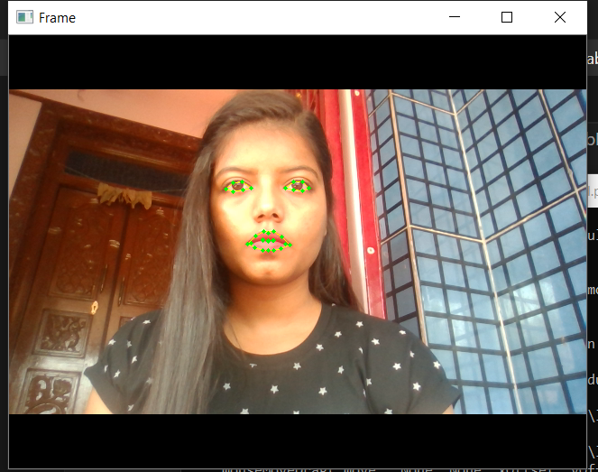
OUTCOMES

Slide 33

EXPECTED OUTCOMES

Slide 34
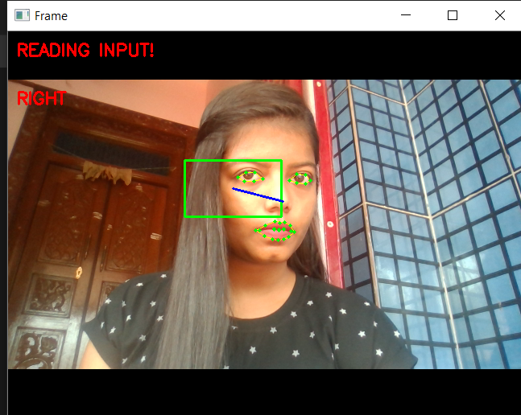
EXPECTED OUTCOMES

Slide 35
EXPECTED OUTCOMES

Slide 36
REFERENCES
[1] Q. Sun, J. Xia, N. Nadarajah, T. Falkmer, J. Foster, and H.Lee, “Assessing drivers’ visual-motor coordination using eye tracking, GNSS and GIS: a spatial turn in driving psychology,” Journal of Spatial Science, vol. 61, no. 2, pp. 299–316, 2016.
[2] N. Scott, C. Green, and S. Fairley, “Investigation of the use of eye tracking to examine tourism advertising effectiveness,” Current Issues in Tourism, vol. 19, no. 7, pp. 634–642, 2016.
[3] K. Takemura, K. Takahashi, J. Takamatsu, and T. Ogasawara, “Estimating 3-D point-of-regard in a real environment using a head-mounted eye-tracking system,” IEEE Transactions on Human-Machine Systems, vol. 44, no. 4, pp. 531–536, 2014.
[4] R. J. K. Jacob and K. S. Karn, “Eye Tracking in humancomputer interaction and usability research: ready to deliver the promises,” Minds Eye, vol. 2, no. 3, pp. 573–605, 2003.
[5] O. Ferhat and F. Vilarino, “Low cost eye tracking: the current panorama,” Computational Intelligence and Neuroscience, vol. 2016, Article ID 8680541, pp. 1–14, 2016.

Slide 37
REFERENCES
[6] Tobii EyeX, “EyeX,” 2014, http://www.tobii.com/eyex.
[7] GazePoint, “Gazept,” 2013, http://www.gazept.com/category/gp3-eye-tracker.
[8] The eyeTribe, “EyeTribe,” 2014, http://www.theeyetribe.com.
[9] M. A. Eid, N. Giakoumidis, and A. El Saddik, “A novel eyegaze-controlled wheelchair system for navigating unknown environments: case study with a person with ALS,” IEEE Access, vol. 4, pp. 558–573, 2016.
[10] L. Sun, Z. Liu, and M.-T. Sun, “Real time gaze estimation with a consumer depth camera,” Information Sciences, vol. 320, pp. 346–360, 2015.

